Slide 1

Report on Use case Scenario
TriVibe Events
Team: EventFlow
Madhur Mahajan | 102203491
Yash Saxena | 102203915
Jashandeep Singh | 102203295
Department of Computer Science
Under the Guidance of Dr. Damini

Slide 2
Title: Movie, Trip, Cafe, Club, and Sports Booking System for Tri Vibe Events
Primary Actors:
User (End-User who books events)
Event Organizer (Person/Organization creating the events)
System Admin (Managing the system backend and event approvals)
Preconditions:
User is registered with the app.
Events are created by event organizers and approved by the admin.
Payment gateway is functional and integrated.
Use Case 1: Book a Movie
Goal: To allow users to book a movie event.
Scenario:
User logs into the Tri Vibe Events app.
User navigates to the Movie Booking category.
System displays available movie options with details like movie title, venue, time, and rating.
User selects a movie and reviews details.
User chooses the date, time, and seats.
System shows seat availability.
User confirms the booking and proceeds to payment.
System processes the payment and sends a confirmation email with the e-ticket.
User can view booking details under the "My Events" section.
Use Case 2: Book a Trip
Goal: To enable users to browse and book trip events.
Scenario:
User selects the Trips category from the homepage.

Slide 3
System displays upcoming trip packages, locations, dates, and trip organizers.
User clicks on a specific trip to view the itinerary, cost, and available spots.
User selects a trip and the number of participants.
System checks availability.
User confirms the booking and inputs participant details.
System processes the payment and sends booking confirmation with trip details.
User receives reminders for the trip before the departure date.
Use Case 3: Cafe Event Reservation
Goal: To allow users to reserve cafe event spots (e.g., music gigs, special offers).
Scenario:
User goes to the Cafe Events section.
System lists all cafe events (e.g., live music, coffee tasting).
User selects an event and checks the availability of seats or offers.
User confirms the reservation details and selects the date and time.
System processes the booking and displays the QR code for entry.
User receives a notification for the upcoming cafe event.
Use Case 4: Book a Club Event
Goal: To enable users to book tickets for club events or parties.
Scenario:
User navigates to the Clubs category.
System displays available club events, including DJs, venue, and date.
User selects an event and views the details such as dress code and event timings.
User books tickets and selects the number of attendees.

Slide 4
System verifies the availability and processes payment.
User receives an e-ticket and event details.
System sends notifications with reminders for the club event.
Use Case 5: Book a Sports Event
Goal: To allow users to book tickets for live sports events or register for local sports tournaments.
Scenario:
User clicks on the Sports category from the homepage.
System shows available sports events and tournaments.
User selects an event, such as a football match or cricket tournament, and views details.
User books tickets and selects the number of attendees.
System verifies seat or slot availability.
User confirms the booking and completes payment.
System sends the e-ticket and event information to the user's profile and email.
Common Use Cases:
View Event History
User goes to the Profile section and clicks on Event History.
System displays all past bookings and attended events.
User can review or download past e-tickets or receipts.
Add Event to Wishlist
User browses any category (Movies, Trips, Cafes, Clubs, Sports).
User finds an event of interest and clicks Add to Wishlist.
System adds the event to the wishlist for future reference.
User can access the wishlist under their profile.
Cancel Booking
User goes to My Events in the profile section.
System lists all upcoming events.
User selects a booking to cancel.

Slide 5
System confirms the cancellation and processes a refund based on event terms.
User receives a notification of cancellation.
Postconditions:
Booking confirmations are sent via email and stored in the user's profile.
Users receive timely notifications for upcoming events.
Refunds or changes in events are managed by the system and reflected in the user’s profile.
Alternate Flows:
Event Fully Booked: If an event is fully booked, the system notifies the user and offers alternative dates or similar events.
Payment Failure: If payment fails, the system notifies the user and offers to retry or choose a different payment method.
This use case scenario outlines the core functionality of Tri Vibe Events, allowing users to seamlessly book events across different categories such as movies, trips, cafes, clubs, and sports.

Slide 6
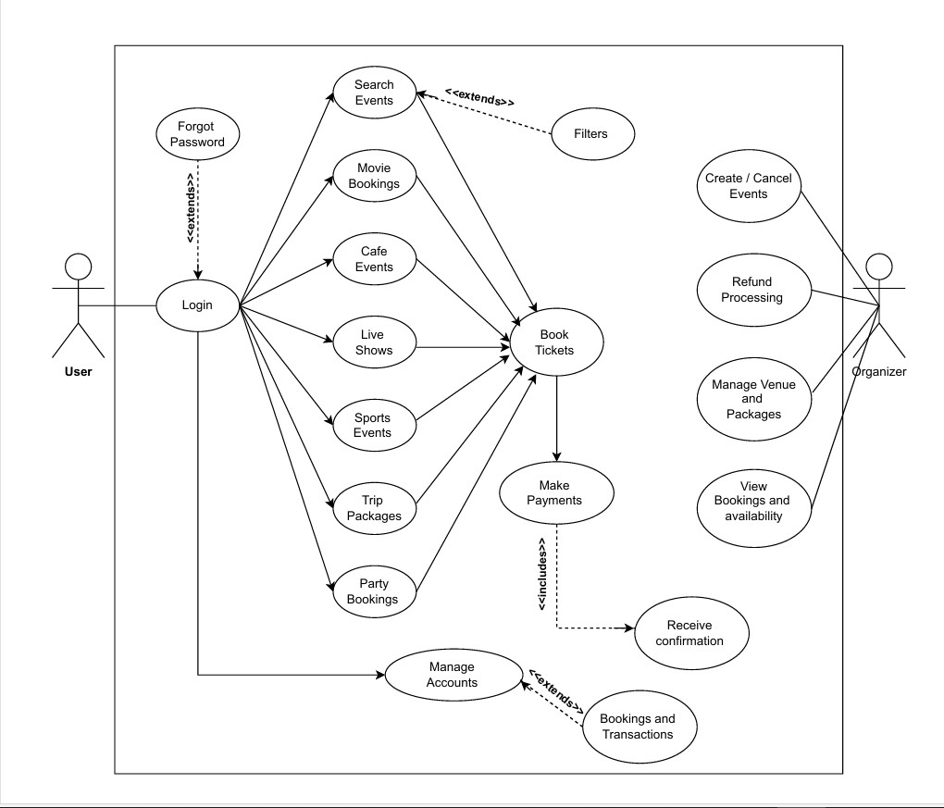
USE CASE DIAGRAM :

Slide 7
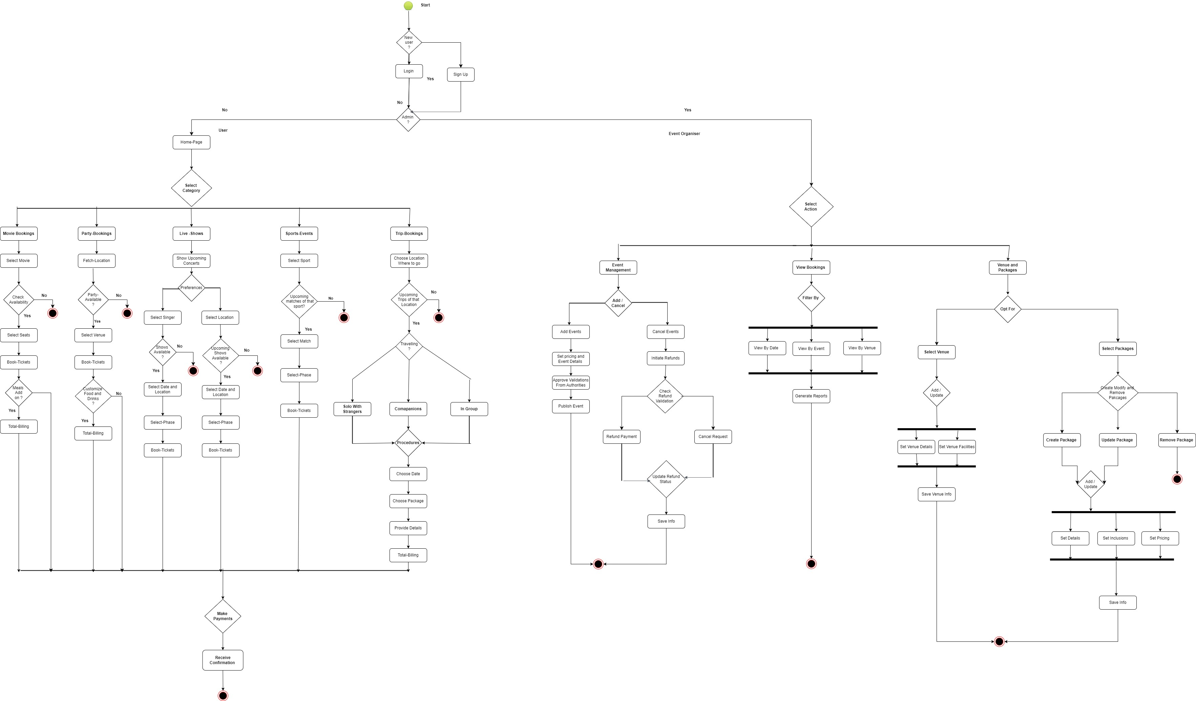

Slide 8
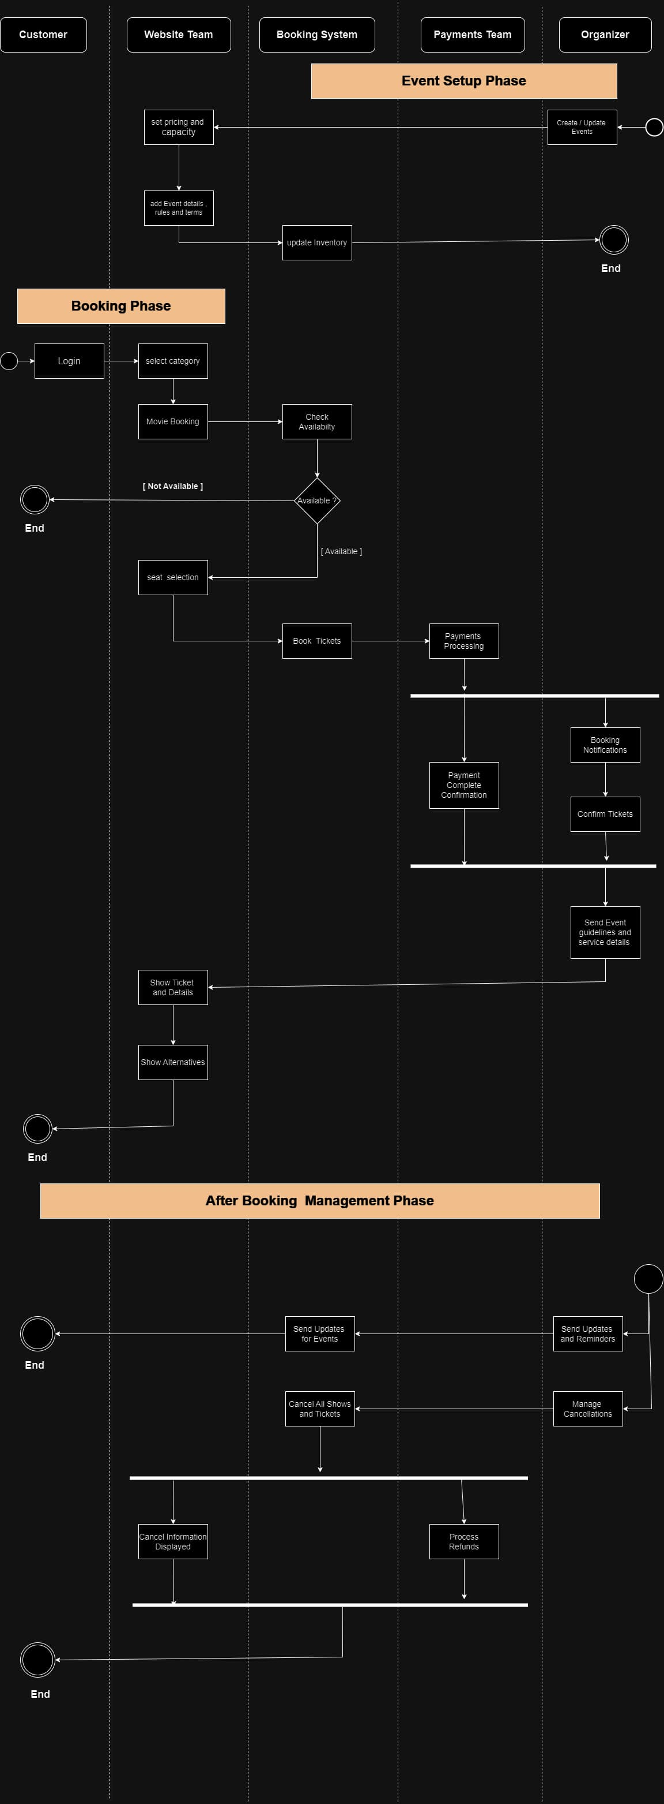

Slide 9
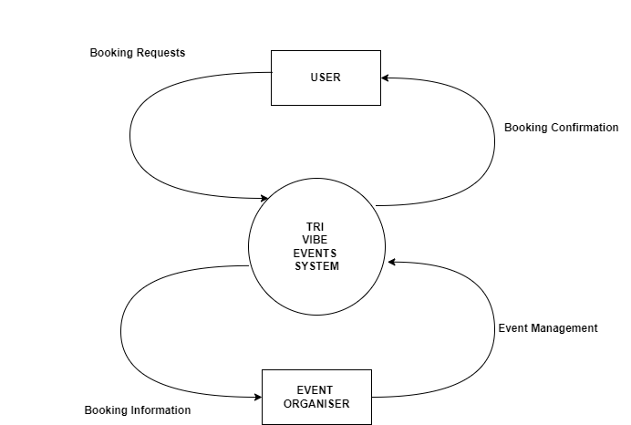
DFD – LEVEL – 0 :
Level 0 DFD:
This is a context diagram showing the highest-level view of the system.
External entities: User and Event Organizer
Central process: Tri Vibe Events System
Data flows: Booking Requests, Booking Confirmations, Event Management, and Booking Information

Slide 10
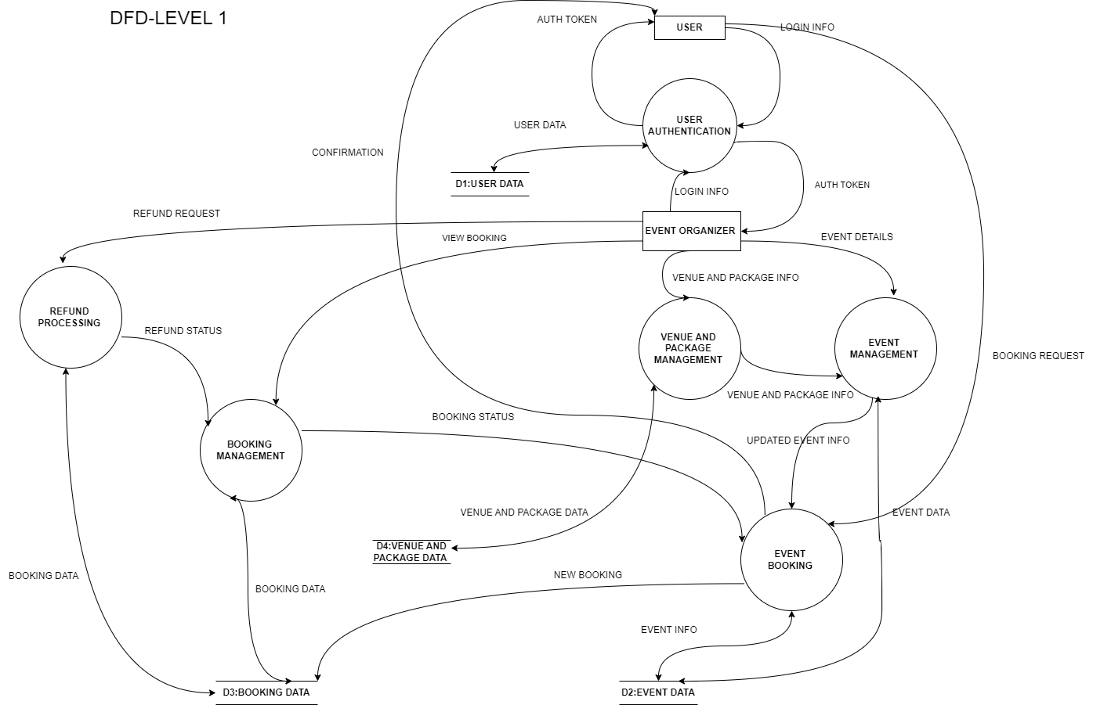

Slide 11
